Slide 1
MEDIPAL
PIP104 PROFESSIONAL PRACTICE-II
VIVA-VOCE
Batch Number:
Roll Number | Student Name
20201CCS0009 | R Shreyas
20201CCS0005 | Vaishnavi M
20201CCS0022 | Shivanand M
20201CCS0120 | Poorva Y
20201CCS0138 | Supriya KP
Under the Supervision of,
Ms. Kaipa Sandhya
Assistant Professor
School of Computer Science Engineering & Information Science
Presidency University

Slide 2
Introduction
Welcome to the future of healthcare – a paradigm shift brought to life through MEDIPAL. This groundbreaking application is not merely a technological advancement but a holistic transformation of how we approach and experience healthcare.
Imagine a seamless convergence of medical expertise, data management, and patient engagement, all encapsulated within a single, intuitive platform. MEDIPAL is not just a tool; it's a healthcare ecosystem reimagined, offering a spectrum of services that transcend traditional boundaries.
At its core, this app serves as a digital nexus, weaving together the intricate threads of medical records, appointment scheduling, and health monitoring into a tapestry of personalized care. Gone are the days of fragmented health information; instead, users wield the power to access, manage, and share their comprehensive health data at their fingertips.

Slide 3
But the brilliance of MEDIPAL extends beyond mere convenience. It's a guardian of privacy and security, employing robust measures to safeguard sensitive health information. This fortress of confidentiality ensures that users can trust the app as a custodian of their well-being.
What truly sets this innovation apart is its commitment to inclusivity. Bridging generational gaps, the app is designed for universal accessibility, catering to both tech-savvy individuals and those less familiar with digital interfaces. It's a healthcare revolution that leaves no one behind.
Interoperability is the heartbeat of this application, fostering seamless communication among disparate healthcare systems. Health records are no longer confined within silos but flow effortlessly, enhancing coordination among healthcare providers and ultimately elevating the quality of care.
MEDIPAL is more than a tool for the present; it's a visionary solution for the future of healthcare. It envisions a world where patient empowerment, data-driven insights, and medical collaboration converge to create a new standard of healthcare excellence. Welcome to a healthier tomorrow, welcome to MEDIPAL

Slide 4
Literature Review
S.NO | ARTICLE NAME | YEAR AND AUTHOR | ADVANTAGES | LIMITATIONS
1 | Regulation of Digital Healthcare in India: Ethical and Legal Challenges | 2023, Deepika Jain | They are concerns at the level of patient privacy. | The current laws in India that regulate technology do not explicitly address telemedicine
2 | Users’ response toward online doctor consultation platforms: SOR approach | 2021, Sandeep Goyal, Sumedha Chauhan, and Parul Gupta | Convenient, time saving, and even can have Medical health record. | Integrating technology oriented factors with behavioral attributes for determining the behavioral intention of user toward the online doctor consultation platform.
3 | Research on the Impact of mHealth Apps on the Primary Healthcare Professionals in Patient Care | 2021, Majed Kamel Al-Azzam | Health service quality development, clinical error reduction, and resource integration. | The threat to the exposure of personal information by the hacker and sharing with third parties is major part.
4 | Usability of a mobile apps for health professionals: a user-centered approach | 2023, Griselda Manzano-Monfort, Guillermo Paluzie, & Carolina Chabrera | Convenience, easy communication with customers and online usage. | Difficulty to create, the cost to create them, and make them available to people, need updates and support.
5 | Mobile health apps for disease screening and treatment support in low and middle-income countries | 2021, Ernest Osei , Tivani P. Mashamba-Thompson | Take preventive care and avert possibility of common but dreaded diseases. | Future research efforts and policy dialogue should be directed to explore health system readiness for adopting sustainable solutions to improve

Slide 5
Research Gaps In Existing Methods
Fragmented Data
Security Concerns
User Adoption
Limited Integration
Reliability and Accuracy
Regulatory Compliance

Slide 6
Proposed Methodology
Needs Assessment
Regulatory Compliance
Team Formation
Concept and Design
Data Security
Data Integration
Development

Slide 7
Testing and Quality Assurance
Regulatory Clearance
User Training and Onboarding
Launch
Data Analytics
User Support
Security Updates

Slide 8
Objectives
Enhance Communication
Optimize Data Efficiency
Improve Access to Healthcare
Ensure Data Security and Privacy
Facilitate Appointment Management
Promote Telemedicine Services
User-Friendly Interface

Slide 9
System Design & Implementation
SYSTEM DESIGN:
Designing an integrated healthcare app involves considering various components such as user roles, data security, interoperability, and user experience.
Key elements include:
User Roles and Access Control:
Interoperability
Data Security
Scalability

Slide 10
User Experience
Telemedicine Functionality
Data Analytics
Notification and Alerts
Compliance with Regulations
Mobile Responsiveness
Emergency Features
Continuous Testing and Monitoring

Slide 11
Implementation
To build MEDIPAL, consider using a combination of front-end technologies like React Native or Flutter for cross-platform development.
For the back end, use a robust framework such as Django or Ruby on Rails, and a database like PostgreSQL or MongoDB.
Implement RESTful APIs for seamless communication between the front end and back end.
Prioritize security measures, including data encryption and user authentication.

Slide 12
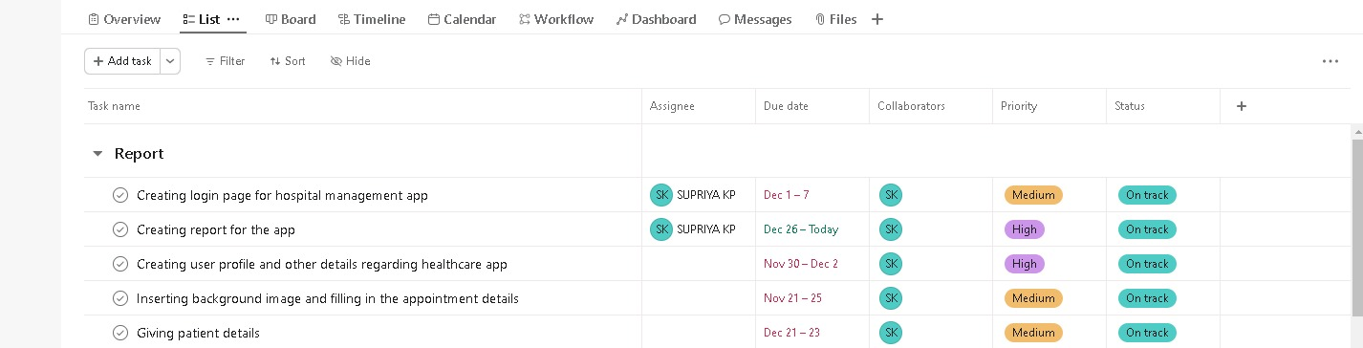
Timeline of Project

Slide 13
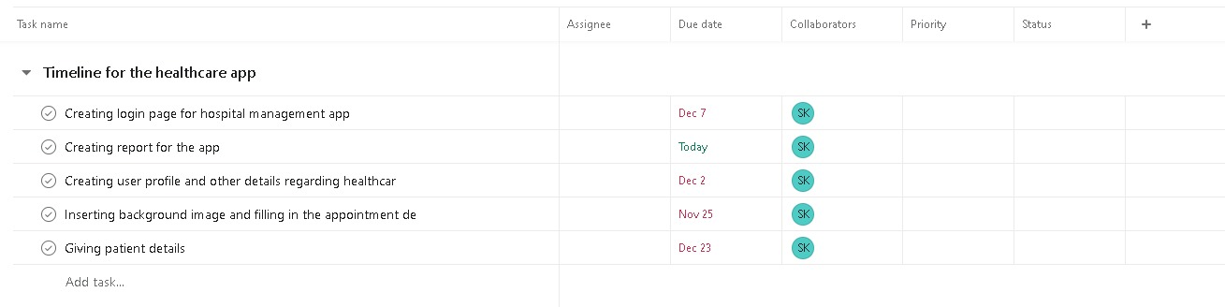

Slide 14
Outcomes / Results Obtained
Enhanced Patient Engagement
Improved Communication
Streamlined Appointment Management
Efficient Prescription Management
Health Monitoring and Management
Enhanced Data Security and Privacy
Operational Efficiency for Healthcare Providers
Data Analytics and Insights
Compliance with Regulatory Requirements
Increased Patient Satisfaction

Slide 15
Conclusion
In conclusion, the MEDIPAL app presented in this report emerges as a transformative tool with immense potential to revolutionize the healthcare landscape. Through its user-friendly interface, robust features, and seamless integration with modern technologies, the app addresses critical challenges in healthcare delivery and patient engagement.
The app's ability to enhance accessibility to healthcare services, streamline communication between healthcare providers and patients, and facilitate remote monitoring signifies a significant step forward in promoting preventive care and early intervention. The incorporation of cutting-edge technologies such as AI-driven diagnostics, telemedicine, and personalized health recommendations further underscores its adaptability to the evolving needs of the healthcare industry.
Moreover, the positive impact of the healthcare app extends beyond individual patient care to contribute to the broader healthcare ecosystem. It has the potential to alleviate the burden on healthcare systems by reducing unnecessary hospital visits, optimizing resource allocation, and fostering a more efficient healthcare delivery model.

Slide 16
As we move forward, it is imperative to recognize the importance of continued innovation, user feedback, and collaboration with healthcare professionals to refine and enhance the app's functionality. Additionally, addressing concerns related to data security and privacy remains crucial to fostering trust among users and stakeholders.
In essence, the healthcare app analyzed here report emerges as a promising solution that not only facilitates a paradigm shift in healthcare delivery but also holds the promise of improving health outcomes, reducing costs, and ultimately contributing to a healthier society. It stands as a testament to the transformative potential of technology in shaping the future of healthcare.

Slide 17
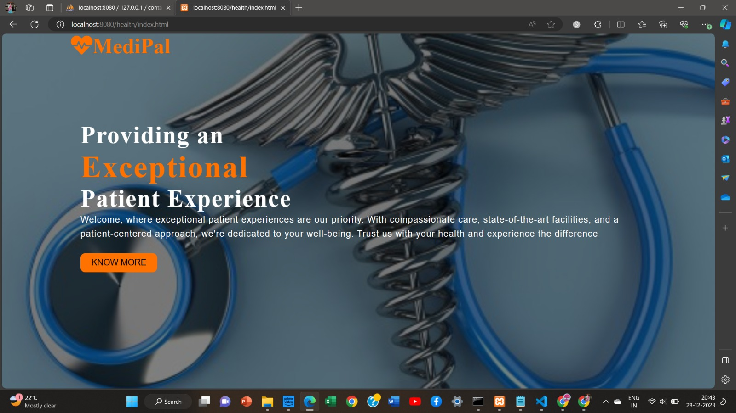
Main page

Slide 18
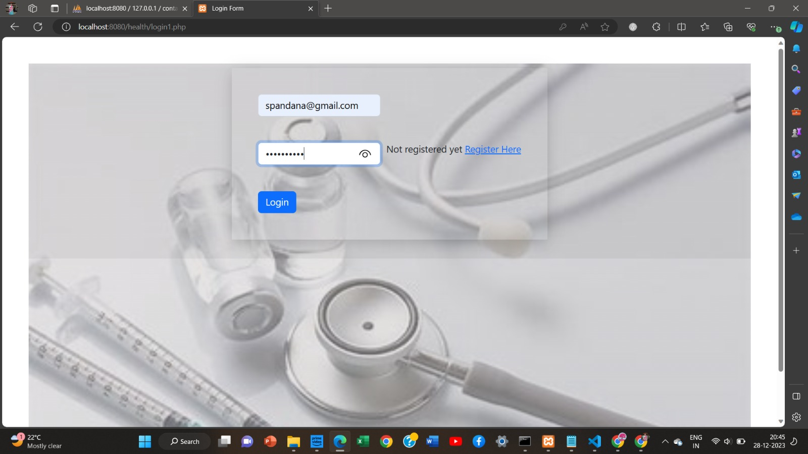
Login Page

Slide 19
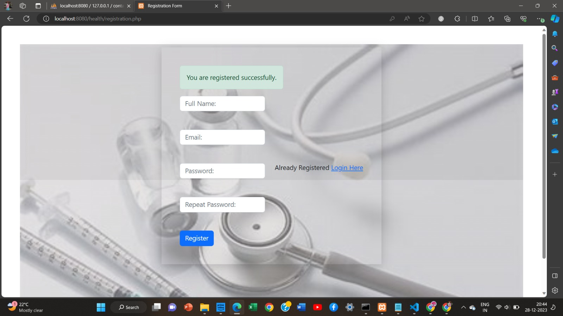
Register page

Slide 20
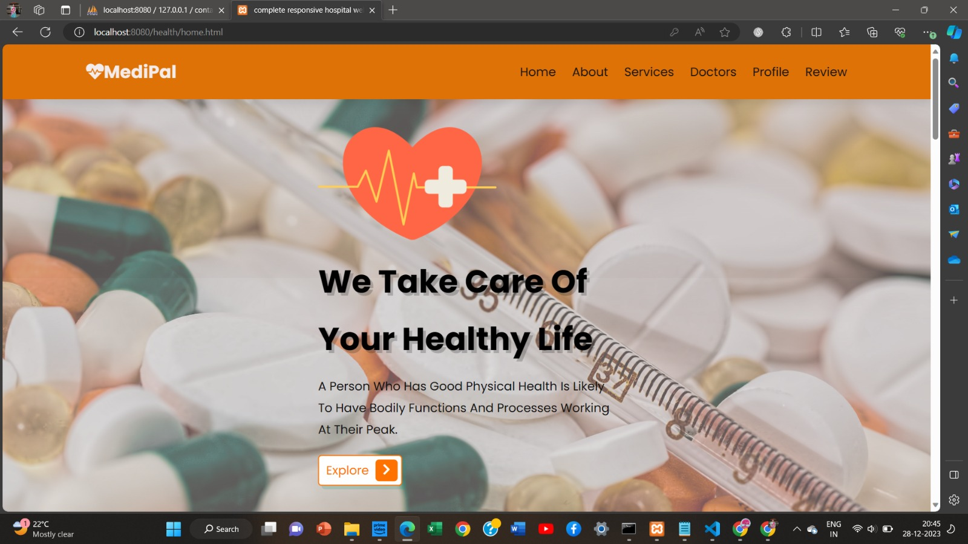
Home Page

Slide 21
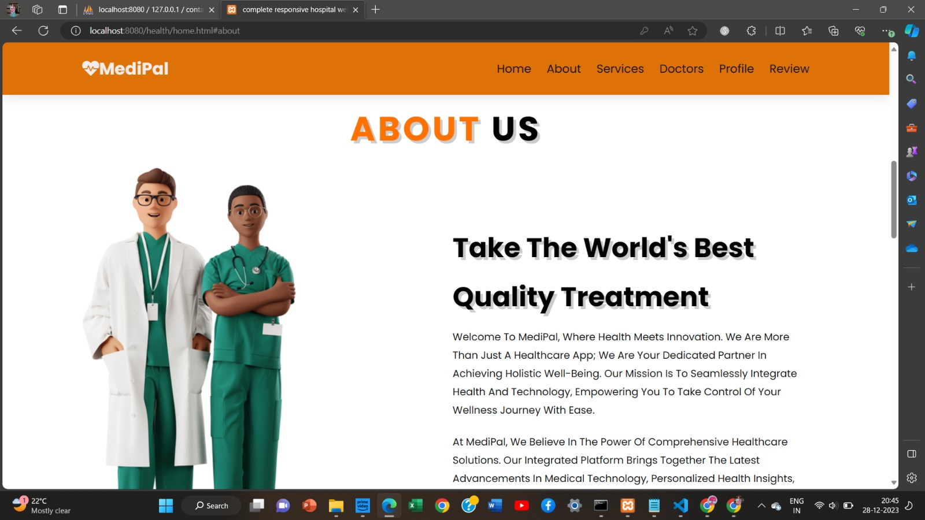

Slide 22
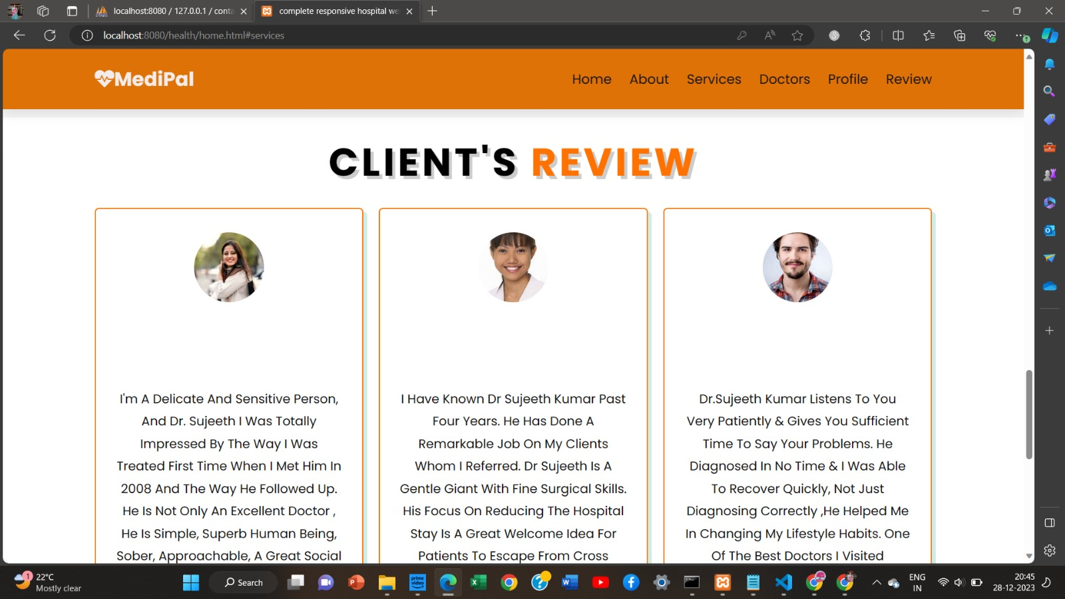

Slide 23
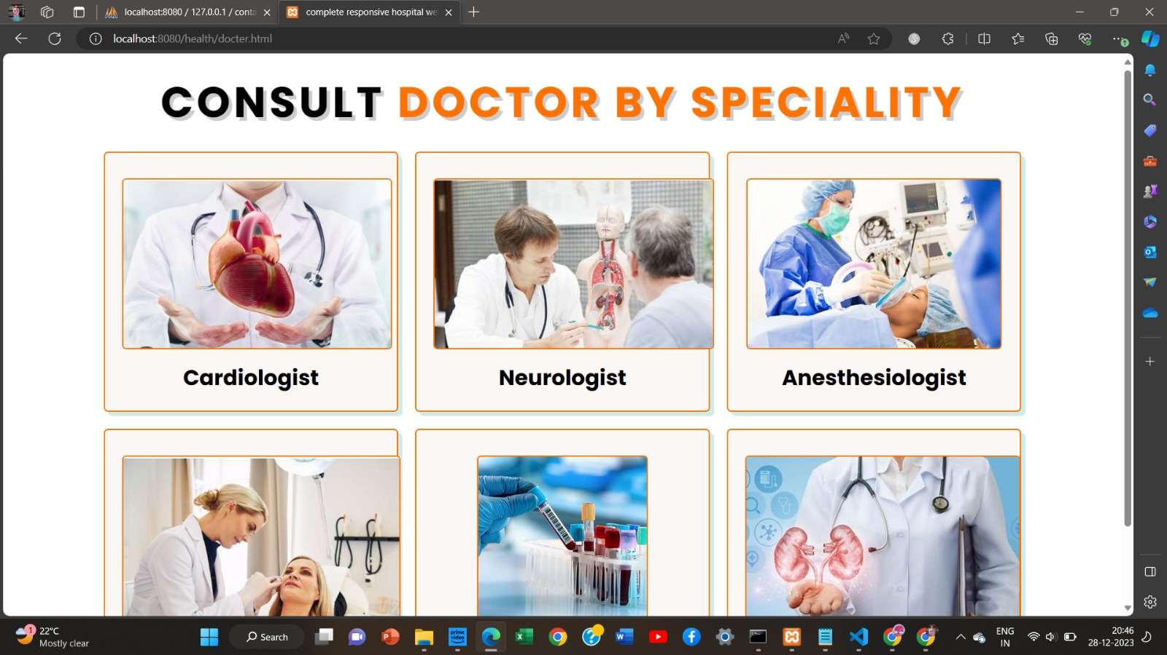

Slide 24
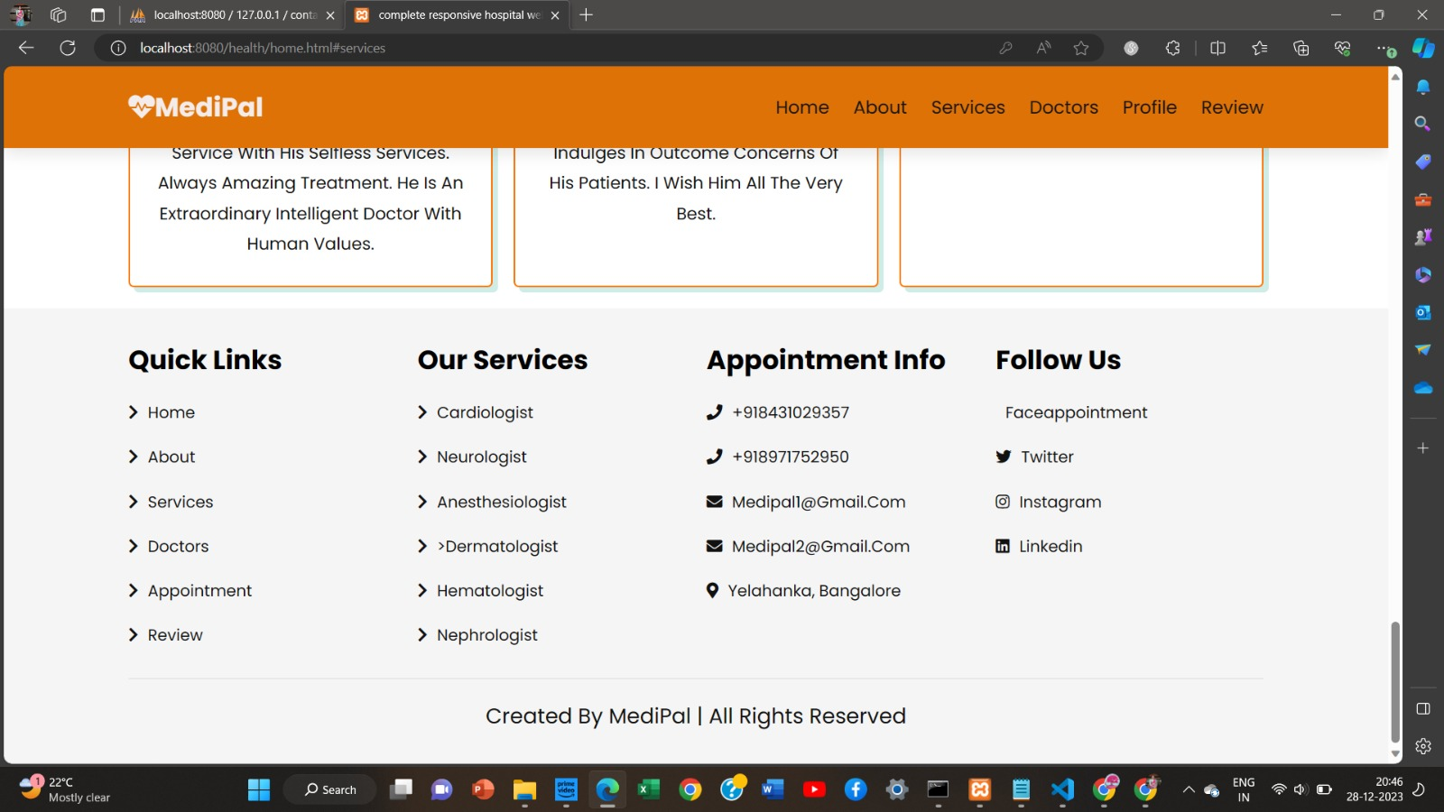

Slide 25
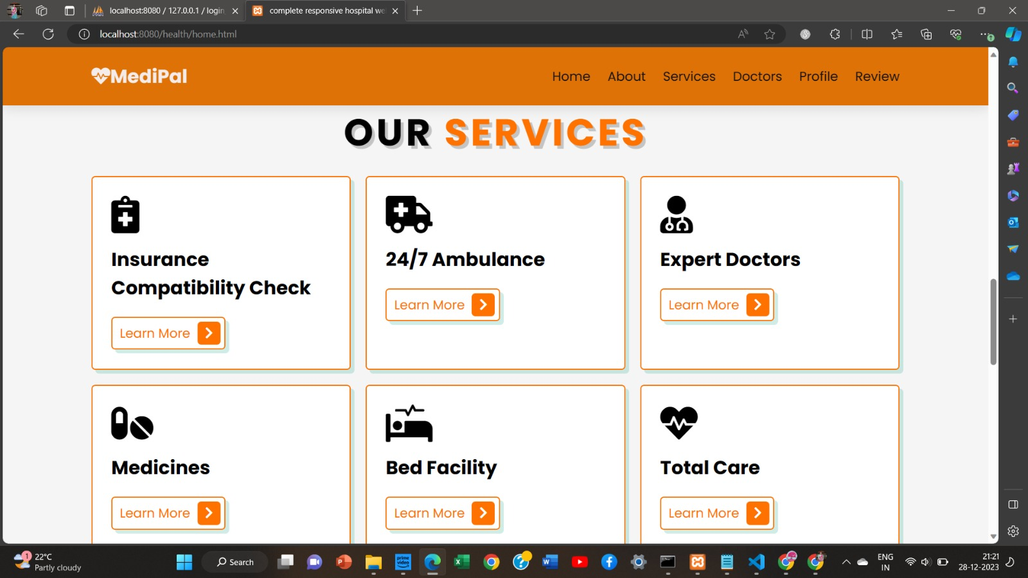
Services Page

Slide 26
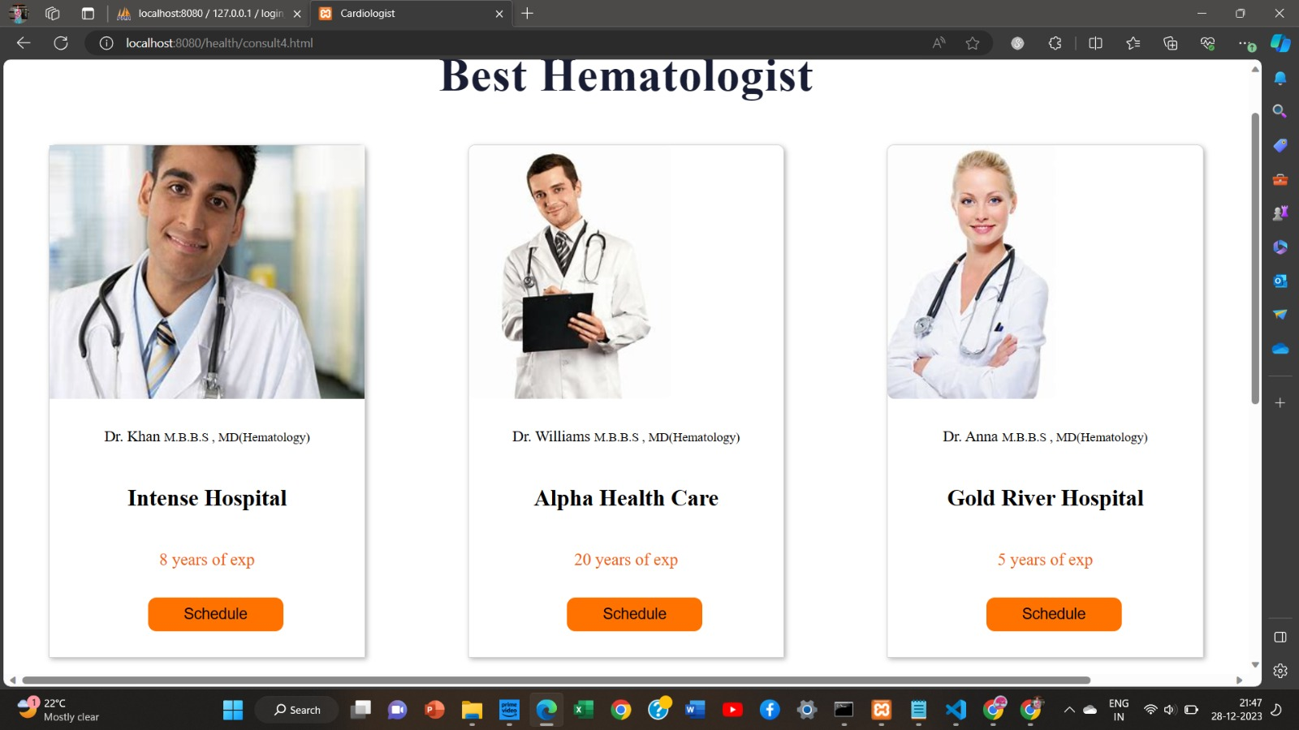
Doctor Speciality Page

Slide 27
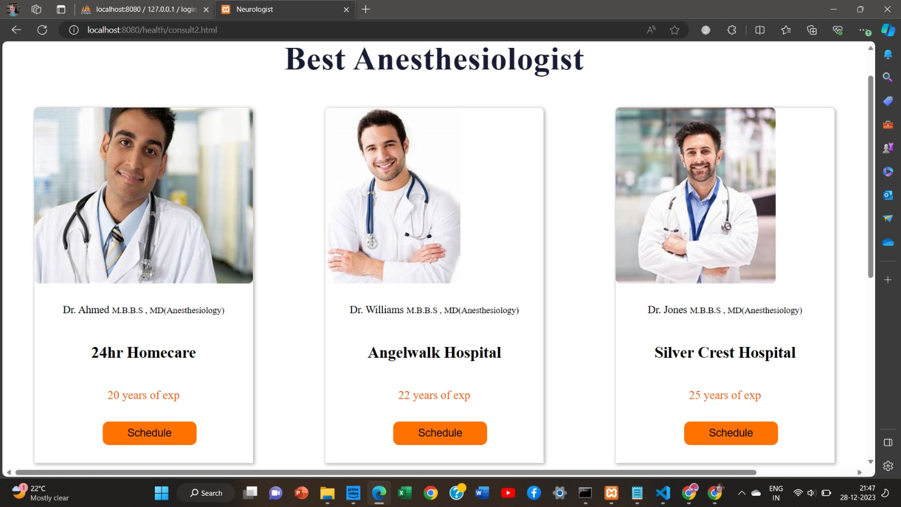

Slide 28
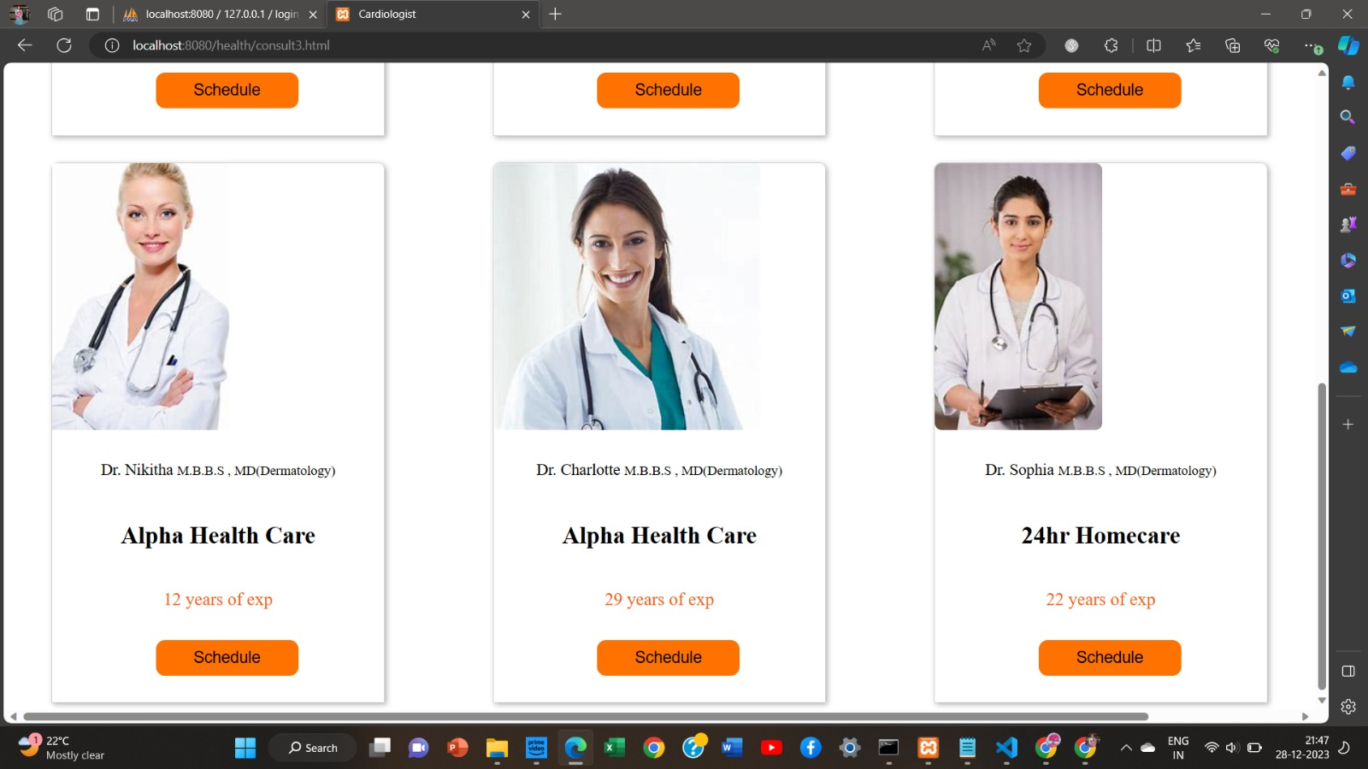

Slide 29
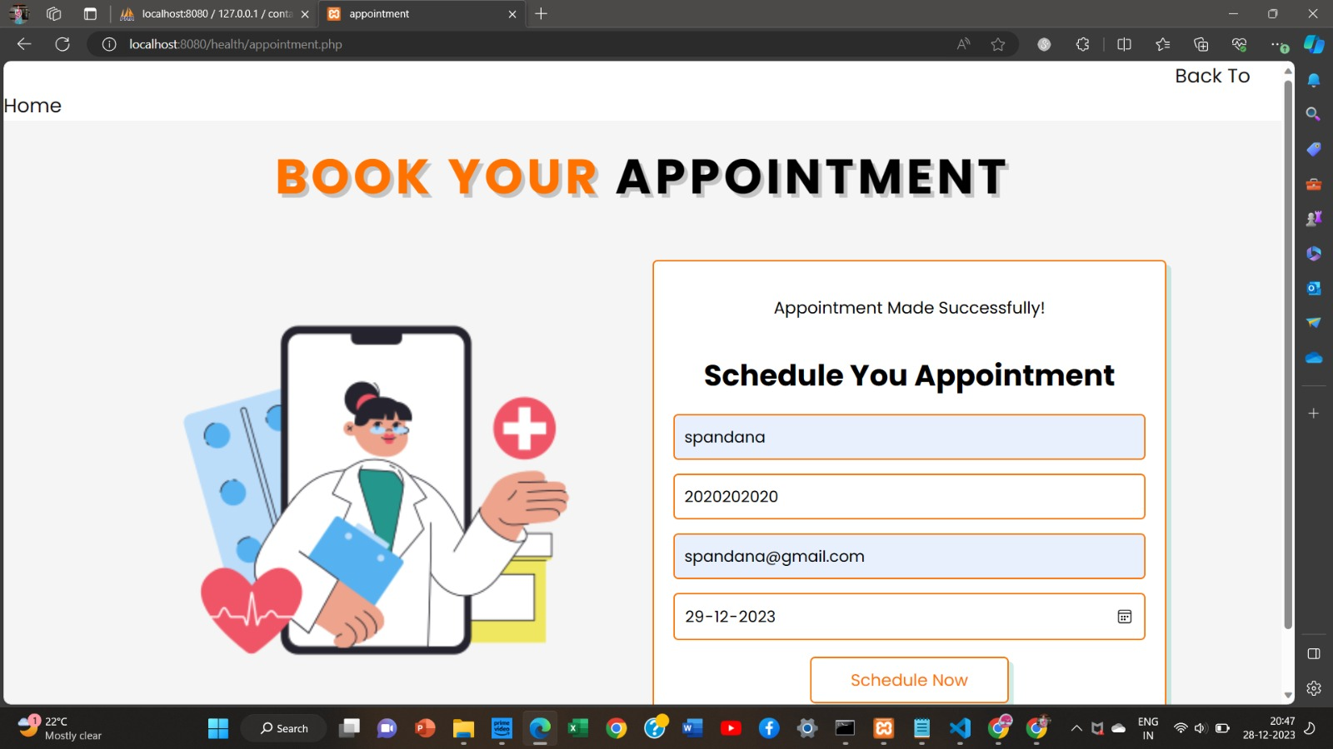
Appointment Page

Slide 30
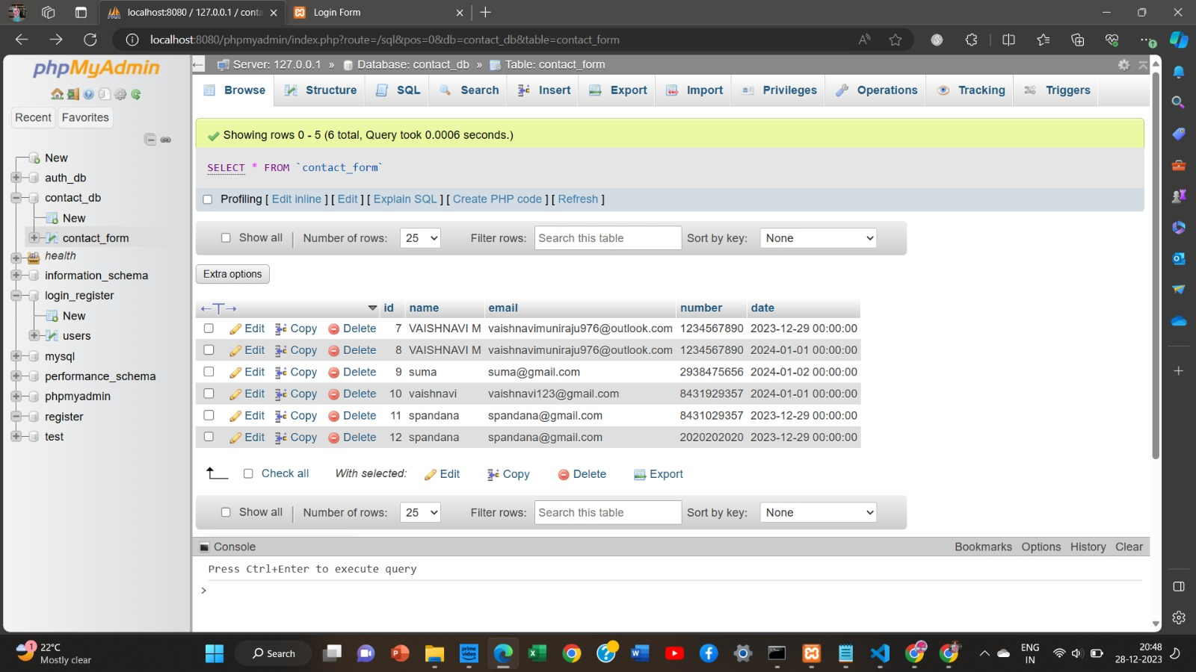
Database Page

Slide 31
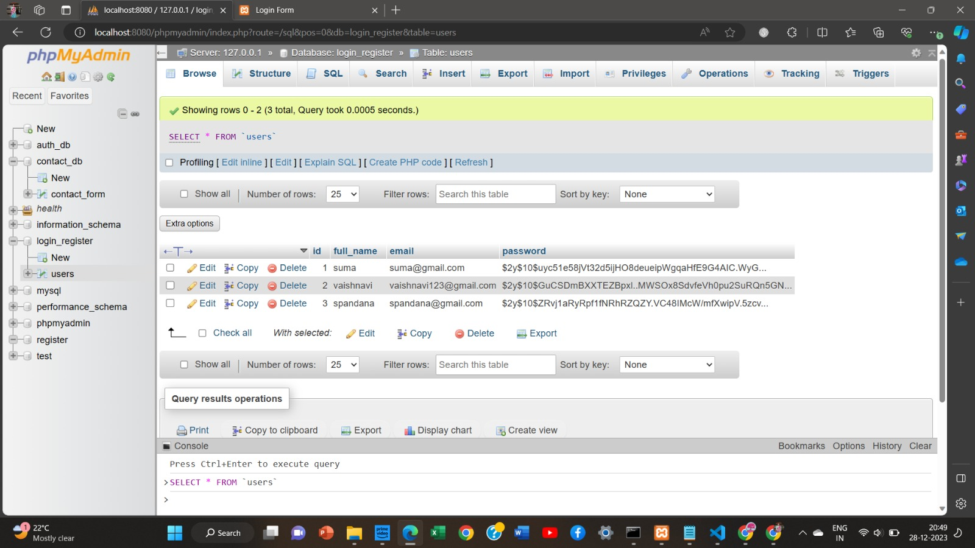

Slide 32
References
https://www.emerald.com/insight/content/doi/10.1108/ITP-11-2021-0835/full/html
https://www.emerald.com/insight/content/doi/10.1108/MD-02-2021-0268/full/html
https://www.emerald.com/insight/content/doi/10.1108/LHTN-07-2017-0052/full/html
https://www.emerald.com/insight/content/doi/10.1108/AJIM-07-2021-0211/full/html

Slide 33

Thank You

